Slide 1
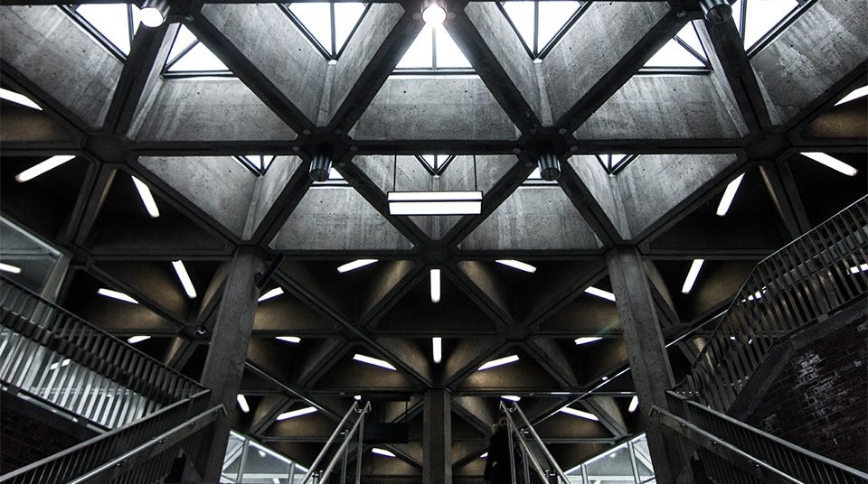
Using a deployment technology to facilitate a development challenge
2
+
2
+
Dockerized NodeJS mockup for a production REST server

Slide 2
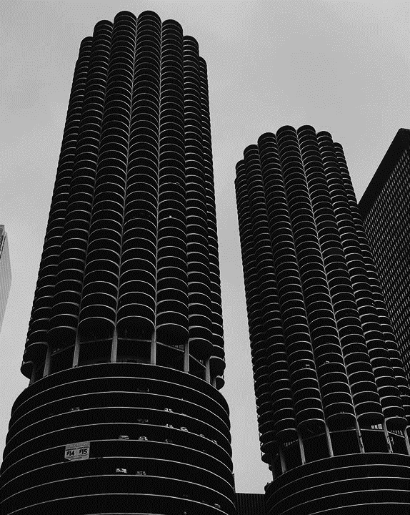
The challenge
2
+
Production REST server required during development
Due to licensing and intellectual property restrictions, a critical component (a REST server) must be developed on a dedicated development machine in a production site, while the rest of development is implemented in our local R&D facilities, unable to access the REST server.

Slide 3

The solution
2
+
Dockerized mockup server
To allow development to continue in our local R&D facilities, a hybrid component, recorder + playback, was introduced
Recording functionality: Given a URL, the hybrid component retrieves the content from the production REST server into local files.
Playback functionality: Given a URL, the hybrid component plays back the content from the previously recorded local file.
Docker: Facilitates the execution of the playback functionality in either developers machines (using Docker Desktop) or Jenkins deployed environments (using Docker).

Slide 4

Demo
Recorder (production)
Playback (local R&D)
Record a URL.
Git push.
Git pull.
Docker build.
Docker push.
Docker run.

Slide 5
THANK YOU
2
+
2
+

